Slide 1


DEBUGGING

Slide 2




AGENDA
DEBUGGING IN C#
STEPINTO
STEP OVER
STEP OUT

Slide 3
Debugging
Debugging is the process of finding errors during application execution. It does not mean syntax errors, with which the application cannot be compiled, but on logic errors.

Slide 4
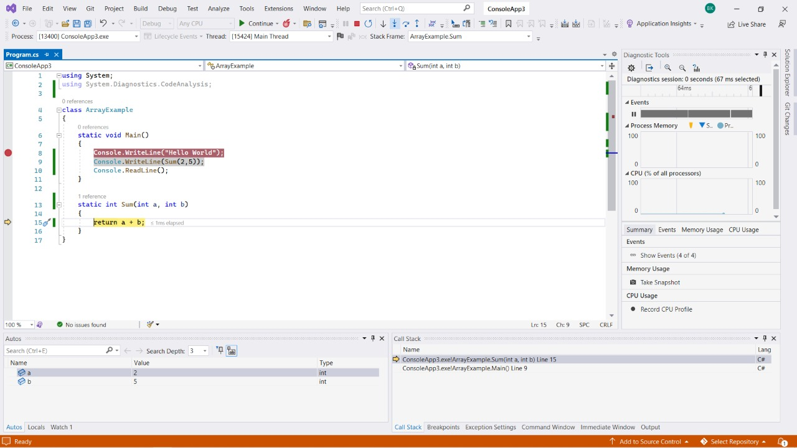
STEP INTO
Executes the current statement and then stops at the next statement. If the current statement is a function then the debugger steps into that function otherwise it stops at the next statement.
We can use F11 to use this function.
In the case of the image, the break point is placed on the eighth line within the Main method.

Slide 5
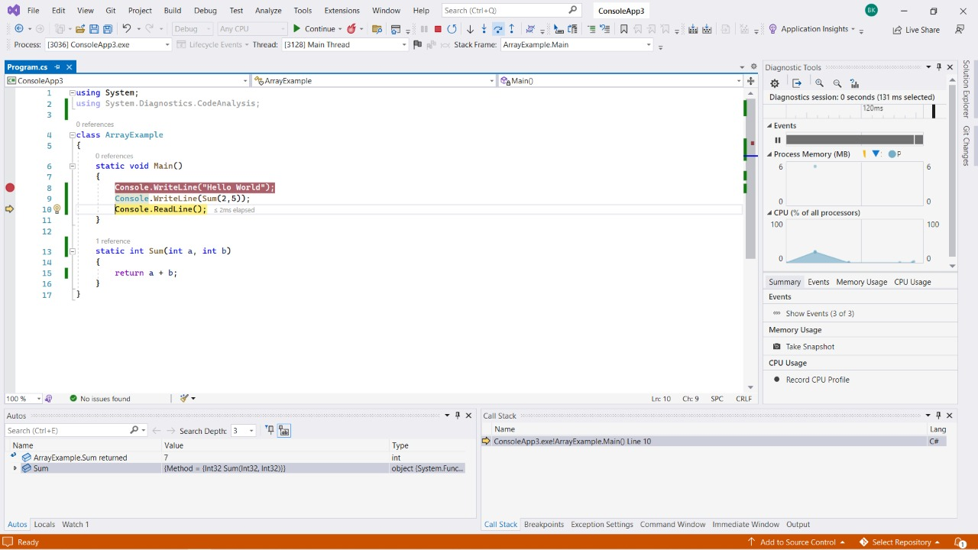
STEP over
Executes the current statement and then stops at the next statement. If the current statement is a function then the debugger executes the whole function. And it stops at the next statement after the function call.
We can use F10 to use this function.

Slide 6
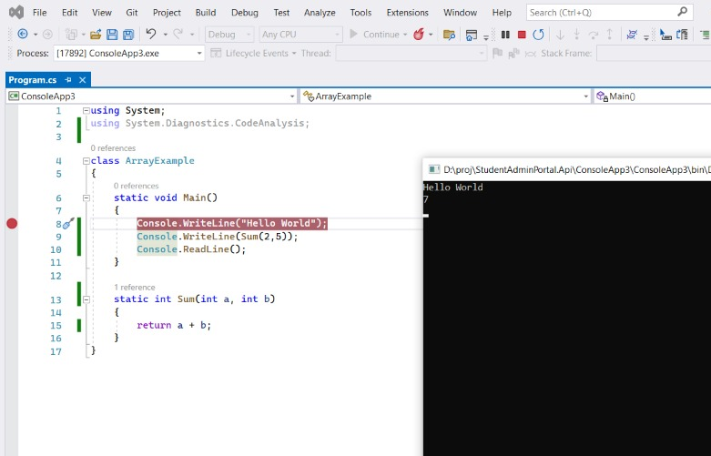
STEP out
Steps out of the current function and up one level if the function is nested. If in the main body the script is executed to the end or to the next breakpoint.
We can use (shift+F11) to use this function.

Slide 7
THANK YOU

